Slide 1
Let’s ‘Face it’: Striving for Fair, accurate and transparent assessment
Dr Karen Ford
Notes:
Use your own title as appropriate but please acknowledge where the activity comes from at some point in the proceedings and invite feedback to pass back to Karen at: karen.ford@shu.ac.uk – thanks.

Slide 2
Learning outcome
By the end of the session, you should be able to:
Discuss how to assess student work accurately and fairly
Notes:
Here are the learning outcomes (this is the one related to the ‘Face it’ activity – see the PDF of entire three hour workshop for wider context)
We will be talking about learning outcomes in relation to assessment later more today.

Slide 3
Overview
Assessment:
Marking student work
Using assessment criteria
Moderation and external examiners

Slide 4
Assessment: Key concepts
Validity: The assessor is measuring what the assessment is intended to measure
Reliability: Consistent marking - as an individual and among markers
Notes:
Briefly outline these and say we will focus on validity first

Slide 5
Constructive Alignment Biggs (2011)
Intended Learning Outcomes
Teaching & Learning Activities
Assessment Tasks
Notes:
Framework for learning design
Intended Learning outcome – what the learners are expected to achieve – intended because you can never be sure that they will achieve them.
Assessment tasks – how the outcomes are measured
Teaching & learning activities - to enable learners to achieve outcomes
Called Constructive Alignment
Don’t linger – simple example coming on next slide
Reference: Biggs, J.B. & Tang, C. (2011). Teaching for quality learning at university: what the student does. Maidenhead: Open University Press, 4th ed.

Slide 6
Example
Learning outcome
Students will be able to identify different types of unfair means
Teaching and learning activities
A lecture on types of unfair means
Assessment task
Multiple choice exam questions which require identification of types

Slide 7
Decision makers and processes
Who decides
Learning outcomes
Assessment tasks
Teaching and learning activities
When and how?
Notes:
1 minute with a neighbour to discuss
For a module (programme too) who decides?
When?

Slide 8
Answer…
Course Directors/Module convenors
When programmes/modules created or revised
Approval via a university process
Not part of your remit(?), but marking validly and reliably is(!)
Notes:
Present these answers and see if they have anything to add.
Then move on.

Slide 9
Validity
So how can we ensure the assessor (you as marker) is measuring what the assessment is intended to measure?
Time to do some marking…
Notes:
There is likely to be a wide range of knowledge amongst participants about assessment criteria.
The first activity is designed to help us consider why we use assessment criteria, ILOs and briefs and what happens when we don’t.
Ask participants who are knowledgeable about assessment to please just go with it, so others get the benefit of working through the process.
Ask all while marking write down any issues or observations to fed into later discussion.

Slide 10
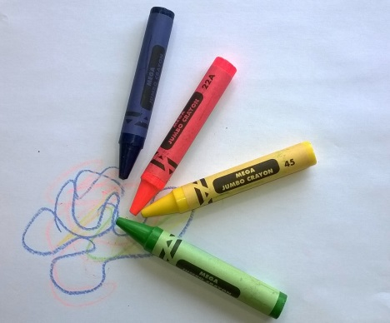
The design brief
Create an illustration for a greeting card using the theme “Emotions”. The illustration should use a range of colours and the design should be flexible to enable adaptation to a range of card formats.
Notes:
Ask participants to imagine they are a design tutor(!)
This the design brief their students were given

Slide 11
Grade the illustration
Merit?
Pass?
Fail?
Notes:
Tell them to get ready to grade the illustration
Three possible grades: Merit, Pass or Fail
They will be given 2 minutes to decide on their own. While marking write down any issues, or observations to feed into later discussion.

Slide 12
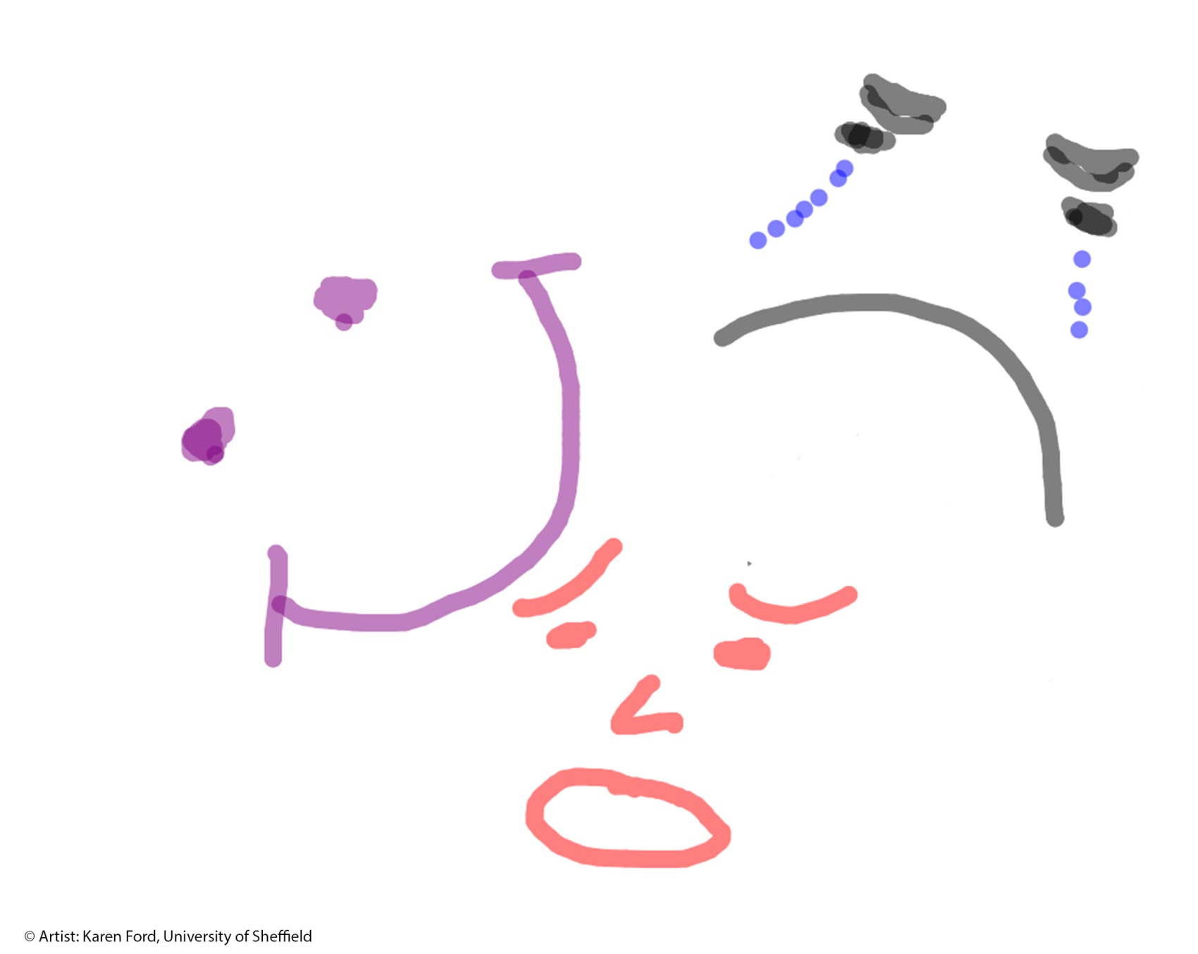
Notes:
Give 1-2 mins to make a decision then:
If you have a small group (less than 40):
Give the blank white cards and get them to record their grade privately without discussion and turn the card face down in front of them.
When you give the signal they reveal the grade awarded to each other.
They take a tally for each grade on the table and report back – summarise in tabular form on whiteboard if poss.
If in larger group:
Take a show of hands for each grade:
Who thinks Pass, Merit, Fail?

Slide 13
Marking outcome
Did we all agree on the grade to be awarded?
Why, why not?
If we all agree, have we marked accurately?
Ask yourself how would we know? (think about evidence)
Notes:
Did we all agree on a Merit, pass or fail
Why/why not
And even if we did – does this mean we marked accurately?
No- because we do not know how we each came to the judgement we made
Ask them to think about the last question then move to the next slide which lists the evidence for achieving learning outcomes

Slide 14
What were we measuring (outcomes)?
Communicates specific emotions clearly
Uses an appropriate range of emotions
Uses a range of colours
Uses space in a flexible way to enable adaptation to alternative card formats
Mark again using these
Notes:
The learning outcomes for this were that students’ illustrations would demonstrate
Create a greeting card illustration on the theme of Emotions that:
Communicates specific emotions clearly
Uses an appropriate range of emotions
Uses a range of colours
Uses space in a flexible way to enable adaptation to alternative card formats

Slide 15
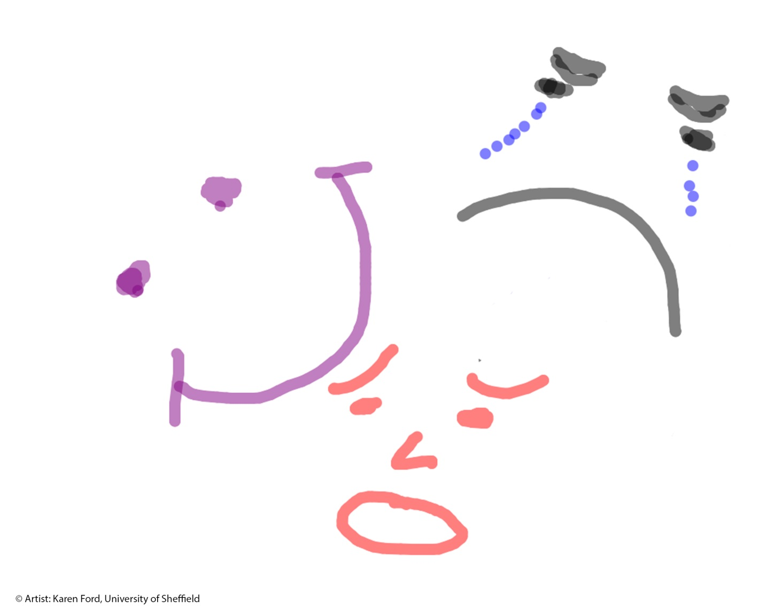
Communicates specific emotions clearly
Uses an appropriate range of emotions
Uses a range of colours
Uses space in a flexible way to enable adaptation to alternative card formats
Notes:
Give a few mins to make a decision then do as before (below):
This time also ask if anyone changed their mind from the first marking…why?
----------------------------------------------------
If you have a small group (less than 40):
Give out blank white cards and get them to record their grade privately without discussion and turn the card face down in front of them.
When you give the signal they reveal the grade awarded to each other.
They take a tally for each grade on the table and report back – summarise in tabular form on whiteboard if poss.
If larger group:
Take a show of hands for each grade:
Who thinks Pass, Merit, Fail?

Slide 16
Marking outcome
Did we all agree on the grade to be awarded?
Why, why not?
If we all agree, have we marked accurately?
What else do we need to know?
Notes:
Did we all agree on a Merit, pass or fail this time
Why/why not
And even if we did – does this mean we marked accurately?
No - because we still do not know how exactly we each came to the judgement we made
We only know what evidence of achievement to look for what else do we need to know?
– elicit answer from whole group (level of achievement)
Or just move to next slide.

Slide 17
Assessment criteria specify
The evidence used to determine the achievement of the learning outcomes
Evidence used to determine the level of achievement
Notes:
We need the level – see next slide

Slide 18
Descriptor | Merit | Pass | Fail
Clarity of emotions | Emotions are clearly identifiable with viewers highly likely to agree on all of the emotions represented, ambiguity is very unlikely. | Emotions are clearly identifiable with viewers highly likely to agree on some of the emotions represented, but a level of ambiguity is evident. | Emotions are not clearly identifiable with viewers highly unlikely to agree on any of the emotions represented; a high level of ambiguity is evident.
Range of emotions | More than four different emotions are evident (the artist has attempted to represent more than three). | Three different emotions are evident (the artist has attempted to represent three). | Less than three different emotions are evident (the artist has not attempted to represent more than two)
Use of colour | More than four colours have been used (not including the background). | Three or four colours have been used (not including the background). | Less than two colours have been used (not including the background).
Use of space | The illustration fits within the chosen format (rectangle or square or circle) and could fit in either of the other formats with little or no work required. | The illustration fits within the chosen format (rectangle or square or circle) but some work would be required to adapt the illustration to fit in either of the other formats. | The illustration fits poorly within the chosen format (rectangle or square or circle) and a significant amount would be required to adapt the illustration to fit in either of the other formats.
Notes:
Distribute the assessment criteria handout 1 per person.
Elicit all the names for this item e.g. matrix, rubric etc etc
Tell them they will be given longer to assess this time and that they need to tick the ‘box’ for each aspect to show their decisions for each.
Remind them to write down and issues or observations for the discussion that’s coming up.
If anyone asks about weighting say its equally weighted – if not say nothing about this.

Slide 19
Notes:
After giving them longer (you judge how long) to mark, ask them to calculate/determine the overall grade to be awarded.
Someone should ask about weighting if it hasn’t already come up.
Observe the number of Merit, Pass and Fail as before.

Slide 20
How did we do this time?
Did we all agree?
What issues does this raise for you?
What can you do about them?
Notes:
We might not still all agree – i.e. not consistent among markers – this is reliability which we will talk about next.
Ask them to discuss with peers:
The grade you awarded and why – look for areas of agreement and disagreement
What issues did you discover from discussion and as you were assessing?
After the discussion ask groups or areas of the room to feedback their findings, in particular problems and how they could be addressed.
Things to note if don’t come out of feedback (below are the key ones only – there are many more).
The criteria forces you to ‘pass’ even though the drawing is quite poor and unlikely to be acceptable greeting card material(!)
Point out no learning outcomes related to purpose or atheistic qualities and therefore no assessment criteria for this either
We don’t know the weighting or if any aspect of the criteria has to ‘pass’ for the overall grade to be a pass
How to measure ambiguity – you are marking alone so how can judgements be made about agreement!
Use of terms and their meaning in this case is ‘appropriate use of colour’ really just about the number used – format could be specified in sizes or templates?
Exemplars could be used to ‘standardise’ / calibrate markers before marking to strive for consistency.
Giving the criteria to students and supporting them to develop their assessment literacy (e.g. through working with exemplars)
Finally ask how these issues are dealt with in their own experience of marking – this usually happens without having to prompt.

Slide 21
Valid marking
Discuss any concerns about the criteria to your Module contact (this can help for the future)
However, your opinion of the criteria is irrelevant from a marking point of view
To ‘ensure’ valid marking you must use the criteria
Notes:
Suggestions for what to do if you experience problems with the criteria…pointing out the injustice to students of not applying the criteria consistently when you mark their work.
Also, the problems that arise by of comparing pieces of work with each other instead of using the criteria against each one.

Slide 22
Checklist for markers:
What is the assessment task?
What teaching and learning activities have led to the assessment task?
What learning outcomes are being assessed?
What are the assessment criteria -evidence for achievement and levels

Slide 23
Review: Key concepts
Validity: The assessor is measuring what the assessment is intended to measure
Reliability: Consistent marking - as an individual and among assessors (markers)
…and consistency across assessment activities e.g. exam papers across cohorts (but not your remit?)
Notes:
Recapping this far
Now time for reliability
Standardisation of markers
Inter reliability – between markers
Intra reliability – by same marker
Assessment task reliability (one year to the next and if there is more than one paper).
Inter reliability – between papers
Intra reliability – between questions

Slide 24
Factors Affecting Reliability
With your neighbours….
…..brainstorm the factors that can affect reliability in assessing student work.
…..identify what can be done to improve reliability?
Notes:
2-3 mins with neighbours then be ready to report your ideas back to the group
Take answers to factors that can affect reliability expected responses – subjectivity, bias, ‘the pile’, time constraints etc
Move to next slide for answer to what can be done…

Slide 25
Processes
Standardisation
To the marking criteria for individual marker consistency (before marking)
Ask how your department does this (e.g. samples of work)
Moderation
Consistency among markers
Notes:
These are the processes designed to ensure reliability …well at least strive for it…
What happens in your department?

Slide 26
External Examiners
The purpose of the external examiner system is to ensure:
the assessment system is rigorous, equitable and is fairly conducted,
student performance and degrees awarded are of an appropriate standard and are comparable nationally
Notes:
Ask if anyone has experience of working with an External examiner – draw on that for an overview
If not add your own experience in here.

Slide 27
Add to your checklist…
What is the assessment task?
What teaching and learning activities have led to the assessment task?
What learning outcomes are being assessed?
What are the assessment criteria -evidence for achievement and levels
How will you be inducted?
How will you be standardised (e.g. examples of assessed work)
How will the assessment be moderated (and what is your role?)
Notes:
Practice will vary – check in advance do not wait until you have a pile of marking or skills sessions to assess, ask at the beginning of the module.

Slide 28
Learning outcome revisted
Can you:
Discuss how to assess student work accurately and fairly?
Notes:
Can you do these now?

Slide 29
Reference
Biggs, J.B. & Tang, C. (2011). Teaching for quality learning at university: what the student does. Maidenhead: Open University Press, 4th ed.

